Slide 1
Creating your first PowerShell module in C#
Emanuel Palm & Justin Grote

Slide 2

Many thanks to our sponsors:

Slide 3


Emanuel & Justin

Slide 4

Agenda
Intro to C# module development
Follow along 💻
Anatomy of a C# project
dotnet build, publish & more
Lots of code and examples!
Summary
Q&A

Slide 5
Leverage the .NET ecosystem
NuGet packages and closed-source SDKs
Implement extensible APIs in a more robust way
.NET features that aren’t in PowerShell
Type safety
Generic methods
Interfaces
…
WHY

Slide 6
Useful Scenarios
Interacting with APIs that have an SDK available
Not reinventing the wheel

Slide 7
A few C# or hybrid modules
Pester
Mortar
PoshAnywhere
AzBobbyTables
PSBicep
PrtgAPI
Most of Microsoft’s official modules
More modules than you expect

Slide 8
Tooling
PowerShell
.NET SDK
Code Editor
Visual Studio Code
Visual Studio
Jetbrains Rider
Any C# editor
Notepad (please don’t use notepad)

Slide 9
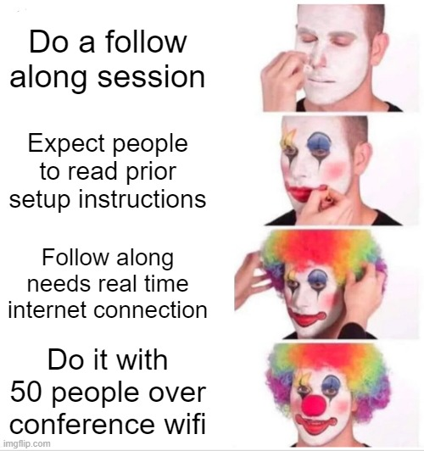

Slide 10
Follow along!
We love Demos!

Slide 11
Q&A

